Slide 1

9Lives Hosptial Management System
The spring and autumn period and the visual studio is one of the enterprises and individuals to provide professional creativity, brand integration design consultants, more than 15 years working experience. To customers as the benchmark, with wisdom grafting business and the arts.
Reporter:XXX

Slide 2



01
Project Overview
02
Application Features
03
UI Snapshots
04
Technologies and Tools
05
Learning Highlights
06
Conclusion

Slide 3
01
Team Members
Team Lead : Aashish
Frontend Team
1. Aman Gautam
2. Hrishita
3. Mansi
Backend Team
1. Aditya
2. Aarav
3. Abhijeet
4. Aman Arya
.

Slide 4
Frontend Team
1. Aman Gautam
2. Hrishita
3. Mansi
Team Lead : Aashish
Backend Team
1. Aditya
2. Aarav
3. Abhijeet
4. Aman Arya

Slide 5
02
Project Overview

Slide 6
9Lives is a hospital management system focused on streamlining role-based functionalities for Admins, Doctors, and Users.
Key features include user authentication, data storage, and role management.

Slide 7
03
Application Features

Slide 8






Core Features
1. Role-based Access Control: Different functionalities for Admins, Doctors, and Users.
2. Secure User Authentication: Login and registration for different roles.
3. Data Management: Custom storage solutions to securely handle user information.

Slide 9
04
UI Snapshots

Slide 10
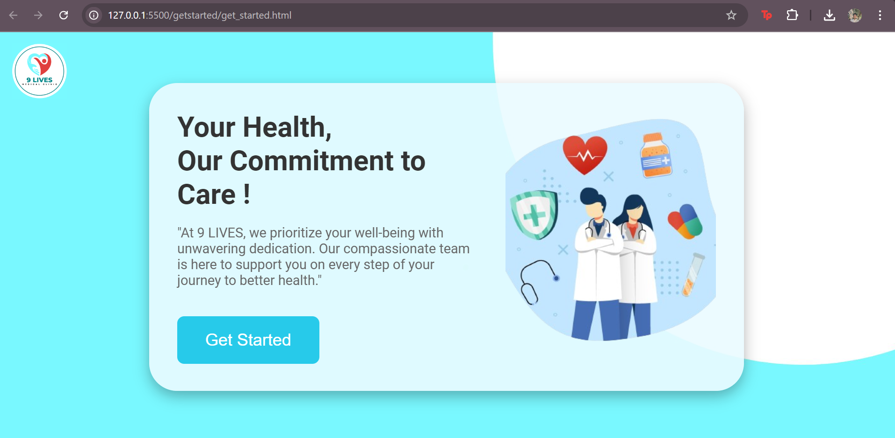
First Page

Slide 11
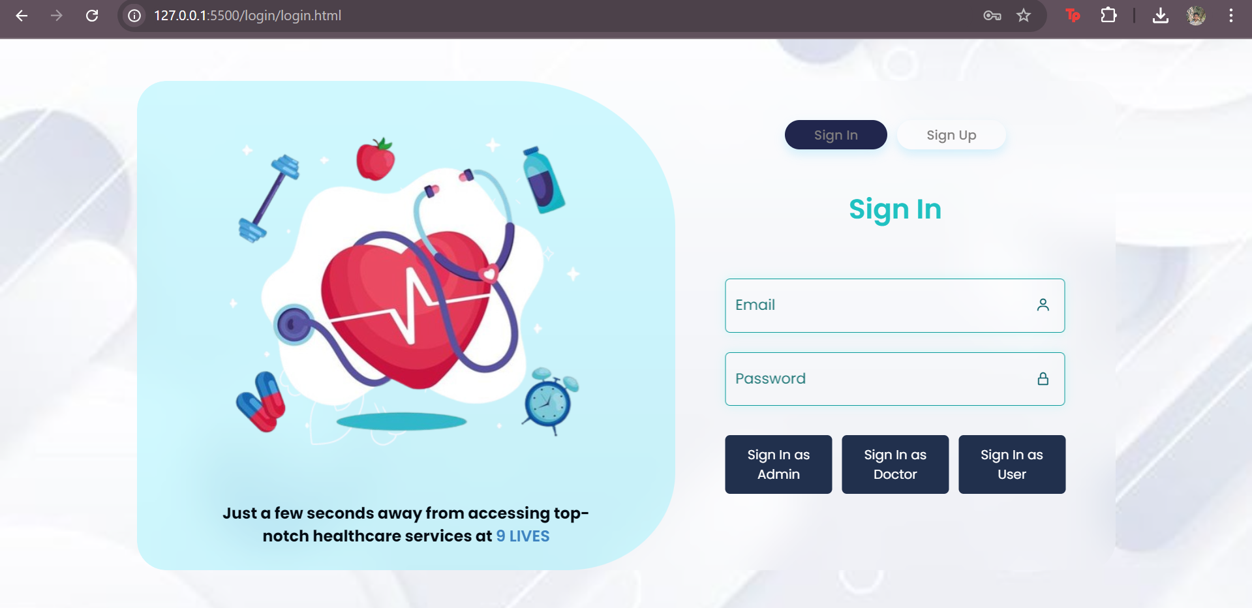
Sign In Page

Slide 12
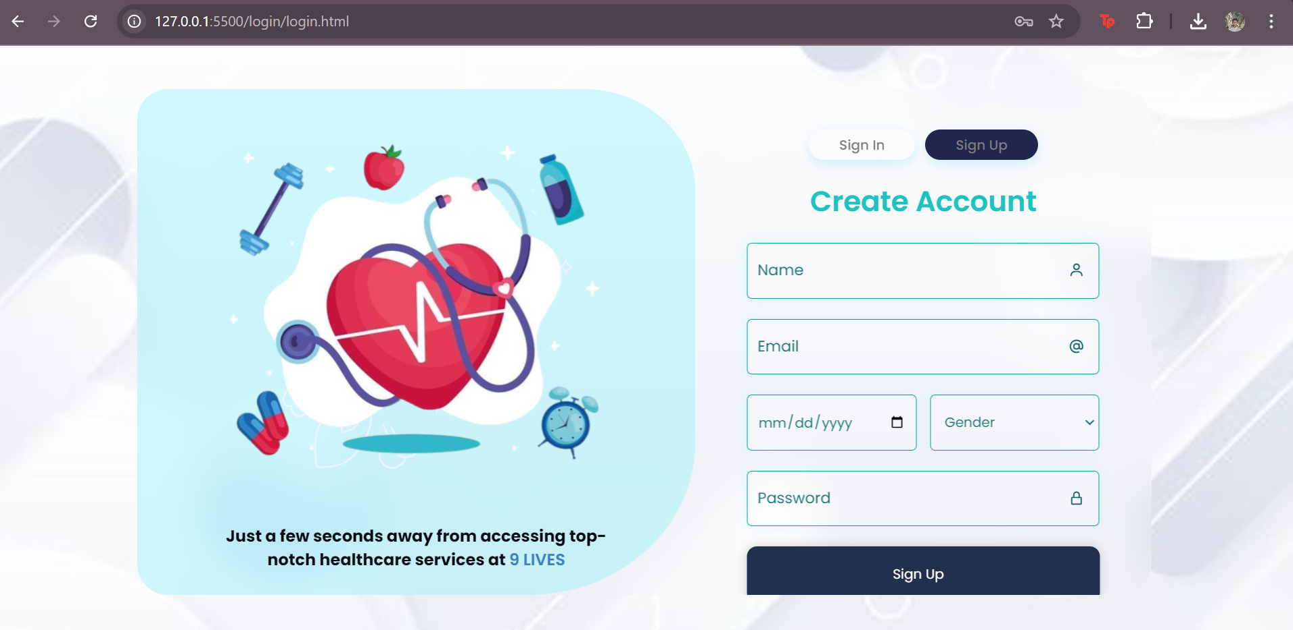
Sign Up Page

Slide 13
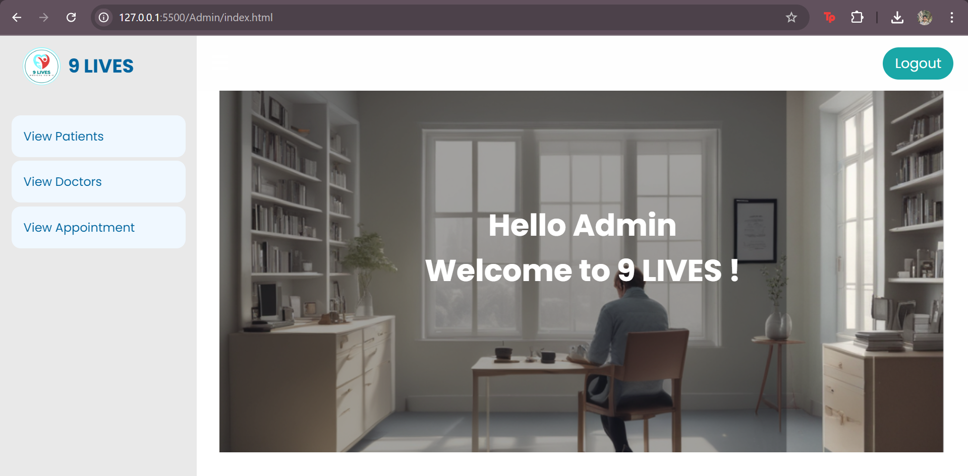
Admin Home Page

Slide 14
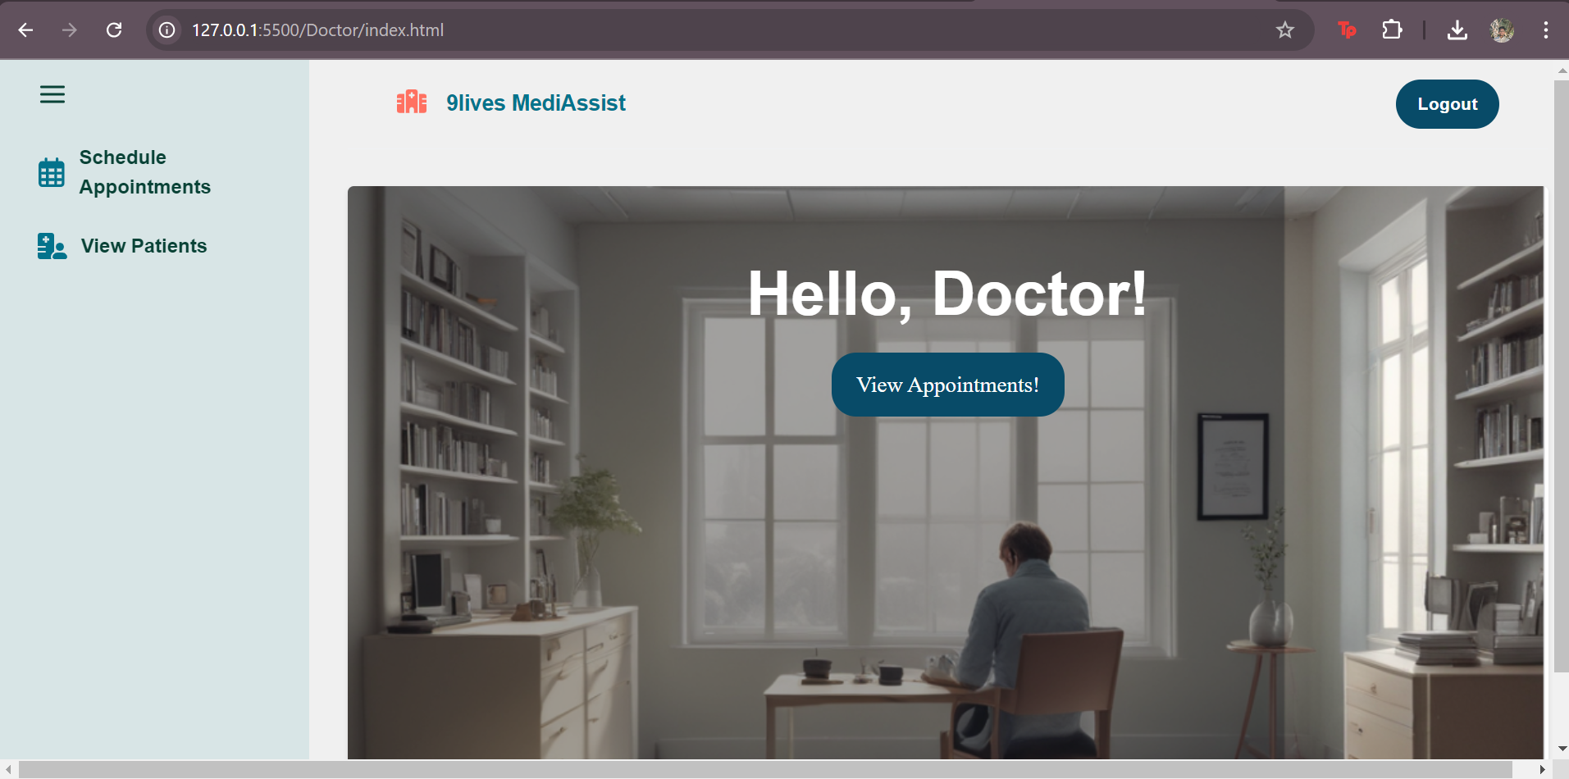
Doctor Home Page

Slide 15
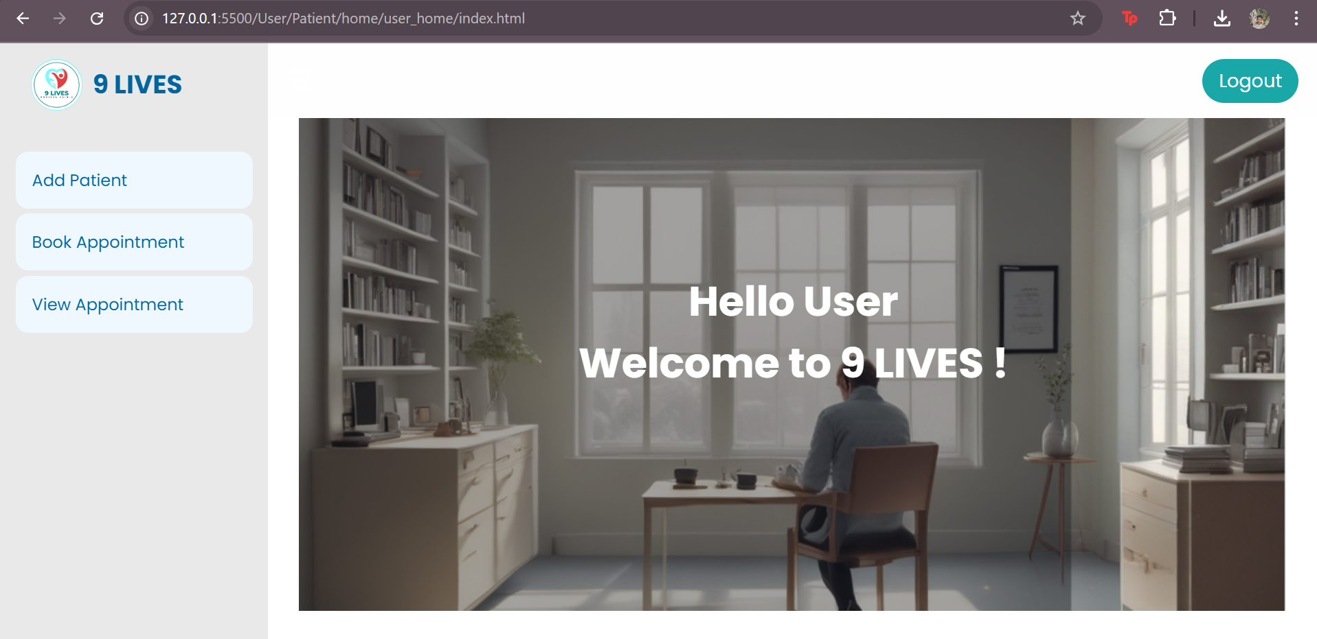
User Home Page

Slide 16
05
Technologies and Tools

Slide 17
Enter title
1. Programming Languages: Java for backend logic.
2. Storage: Custom classes like AdminStorage and Person manage user data.
3. Frameworks: Object-oriented principles and modular design.

Slide 18
06
Learning Highlights

Slide 19

1. Implementation of role-based access control and secure data handling.
2. Collaborative development using Git and clean code practices.
3. Modular code design for scalable and maintainable software.

Slide 20
THANK YOU
9Lives Hospital Management System demonstrates the integration of secure, role-based functionalities and user-centric design.
It serves as an excellent learning experience in building modular, scalable applications.

